Slide 1


Impact of the spectrum management on mobile broadband
General framework and technological choices
Wladimir Bocquet, Senior Director of Spectrum Policy, GSMA
03 MARCH 2014
Notes:
Speaking points
Welcome, introductions and any housekeeping

Slide 2


AGENDA
GSMA Overview
Mobile Markets in the MENA
Economic and Social Contribution of the Mobile
Technical and Regulatory Challenges
Benefits of Releasing Harmonised Spectrum
Summary
GSMA resources
Notes:
Note: Agenda is fully editable — stretch out the boxes to line up with photos
Speaking points
The goal of today’s meeting/workshop/presentation…
We will cover a broad range of topics related to spectrum planning and management, beginning with an overview of GSMA and the pressures on spectrum that are faced by the mobile industry.
And then we delve into spectrum issues that are closer to home, in your market(s)

Slide 3

GSMA
OVERVIEW

Slide 4
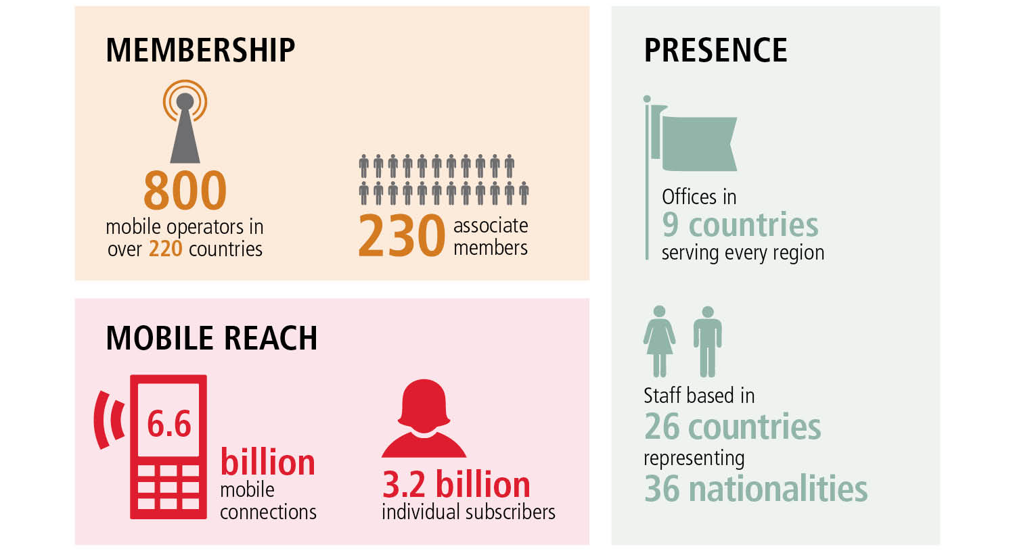
GSMA BY THE NUMBERS
Notes:
Note: 6.6 billion connections is not all based in GSM-family technology — this number includes all technologies.
Speaking points
Here’s a snapshot of the GSMA’s reach around the world.
In addition to our 800+ mobile operator members, our associate members include handset makers, software companies, equipment providers, internet companies, and media and entertainment organisations.
As our members have called for more regionally-focused support and policy expertise, we have expanded beyond London and Brussels to regional business and regulatory centres such as Hong Kong, Buenos Aires, Nairobi, Brasília, Dubai and Delhi.
Our expanding work on many fronts reflects the growth of the industry — which is now providing 3.2 billion individuals with mobile services.
For reference, GSMA’s official office list:
London
Barcelona
Brussels
Atlanta
Santiago
Sao Paulo
Brasilia
India
Hong Kong
Shanghai
Nairobi
Plus homeworking staff in 17 additional countries.

Slide 5



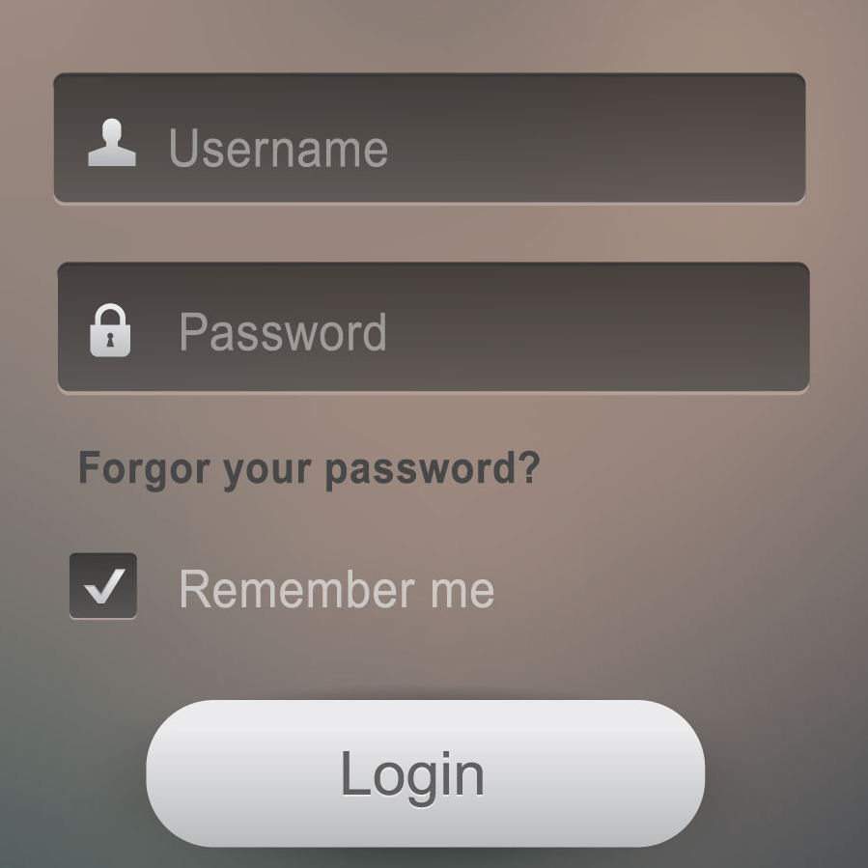


ENABLING A MOBILE FUTURE
ACCELERATING MOBILE INNOVATION
THROUGH GLOBAL INITIATIVES
CONNECTED LIVING
Realising the potential of connected devices across many sectors to improve lives
FUTURE COMMUNICATIONS
Creating an enhanced mobile experience via voice-over-IP, messaging and content-sharing applications
MOBILE COMMERCE
Enabling transactional services via contactless radio technology
NETWORK APIs
Developing interfaces to fully exploit mobile network capabilities
MOBILE IDENTITY
Authenticating users securely
and conveniently
SPECTRUM
Promoting effective spectrum policy and delivery of mobile broadband
Notes:
Speaking points
The GSMA also plays a crucial role in the incubation of mobile technologies and services — initiatives that require collective input and industry buy-in. Our largest programmes are these:
Connected Living
A world where everything intelligently connects
25 billion connected devices by 2020
mHealth solutions could save 1 million lives in sub-Saharan Africa over the next 5 years
mHealth solutions could save $400 billion from healthcare bills in developed countries in 2017
Emergency call solutions could save 1 in 9 lives in car accidents in developed countries over the next 5 years
Smart metering could reduce carbon emissions by 27 million tonnes in 2017
Future Communications (RCS)
Rich Communication Services are transitioning messaging and voice services into an all-IP world
Enabling live chat, image and video sharing, regardless of operating system or network
Supported with mobile operator security, privacy and interoperability
31 operators launched, or committed to launch, under the joyn consumer brand
Mobile Commerce (NFC)
Secure SIM-based NFC makes your smartphone smarter, replacing tickets, cash, credit cards and keys
One billion SIM-based NFC handsets will be sold by 2016
Supporting $50 billion of transactions by 2016
More than 20 operators have launched SIM-based NFC services with many more to follow this year
Mobile Identity
Mobile operators have a key role to play in identity management
The average consumer has 26 online usernames and 5 passwords
The use of the SIM-based identity management will offer consumers and businesses improved levels of convenience, security and privacy
Network APIs
Integrating operator services to create more compelling applications
OneAPI Exchange launching with APIs for mobile identity, mobile messaging and operator billing
Average volume of API transactions for a Tier 1 wireless carrier will reach 94 billion per month by 2016
OneAPI Exchange is powered by Apigee, a leading API development company
Spectrum
And spectrum of course is one of our key initiatives, which is where the focus of this meeting lies.

Slide 6



MOBILE
MARKET
THE ACTUAL PICTURE
Notes:
Speaking points
So with that introduction to the GSMA and our Spectrum Programme, we now turn to mobile broadband — the skyrocketing demand and the obstacles we face in achieving the ultimate goal of broadband for all.

Slide 7
MOBILE CONNECTIONS
The Arab States have approximately 6% of worldwide mobile connections
Global population and mobile connections (2012)
Significant growth in the number of mobile connections
The Sub-Saharan Africa region is the fastest growing region
The MENA region is the second-fastest growing telecoms market globally
Average annual growth rate of more than 32% in the past 10 years, from 19 million in 2002 to 391 million in 2012.
^{Source: GSMA intelligence}
Average annual growth in the number of
^{mobile connections (2002–2012)}
^{Source: GSMA intelligence}

Slide 8
MOBILE BROADBAND PENETRATION
Mobile broadband will be driven in upcoming years by increased penetration of smartphones.
Penetration is forecast to exceed 20% in most Arab States by 2016, with rates as high as 70% in Saudi Arabia.
Smartphones allow users to access entertainment content and be fully connected: a recent survey in Egypt, Saudi Arabia and UAE found that 29%, 60% and 64% of respondents, respectively, access the internet on their smartphone at least once a day.
Total mobile broadband connections in the Arab States (2011–2017)
Source: GSMA intelligence/Deloitte
Usage by type of website in Egypt, Saudi Arabia and UAE (2012)
Source: GSMA intelligence/Deloitte

Slide 9

ECONOMIC AND SOCIAL
CONTRIBUTION
THE MENA MARKET

Slide 10
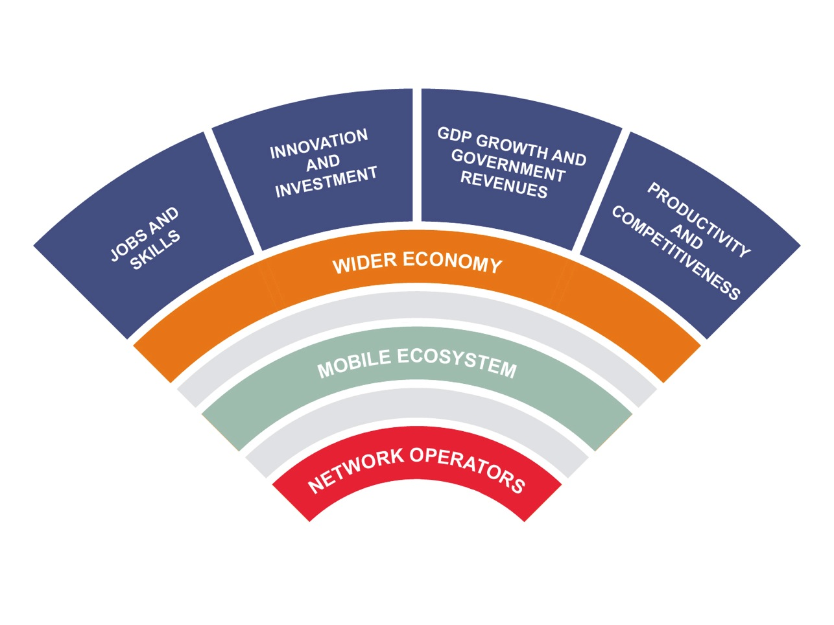
IMPACT OF MOBILE BROADBAND
INCREASED ACCESS TO MOBILE SERVICES BRIGNS SIGNIFICANT BENEFITS TO THE POPULATIONS
Notes:
Speaking points
The roll-out and adoption of mobile broadband services is on the rise everywhere, and this is being accelerated through the gradual release of the Digital Dividend. Continued progress is exceedingly important, and especially for developing economies.
The mobile sector — and the provision of mobile broadband — creates value that radiates out through the economy.
Mobile network operators create economic value directly — by offering a valuable service to citizens, employing people, paying vendors for services, paying taxes and investing in infrastructure and spectrum licences. But it doesn’t end there.
The mobile industry supports an array of businesses:
Device manufacturers and operating system developers are driving innovation in the race to make smartphones faster, lighter and more intuitive to use.
Network infrastructure vendors are striving for further efficiencies, as they seek to support the network demands of tomorrow at lower cost.
Content providers are harnessing the new hardware and software innovations to generate new products and services.
Even beyond the industry ecosystem, mobile strengthens every sector in the wider economy by increasing productivity and providing access to email, applications and the internet at any time. It gives people important new ways to learn and to do business and to buy things. This effect is even stronger in developing countries than in developed economies.
Some telling statistics:
A 10 percent increase in the penetration of broadband services in low- and middle-income countries accelerates economic growth by 1.38% (World Bank analysis of 120 countries).
A 10 percent increase in broadband household penetration delivers a boost to a country‘s GDP that ranges from 0.1 to 1.4%. (McKinsey & Co)
A 10% increase in mobile penetration increases productivity by 4.2%. (Deloitte)
A 10% increase in 3G penetration increases GDP per capita growth by 0.15%. (Cisco)
A 10% increase in broadband penetration translates into a 1.5% increase in a country’s labour productivity over the following 5 years. (Booz & Co)
A doubling of mobile data use leads to an increase in GDP per capita growth of 0.5%. (Wireless Intelligence)
Countries with 80% broadband penetration are more than twice as innovative as countries with 40% penetration. (Booz & Co)

Slide 11
CONTRIBUTION TO THE NATIONAL ECONOMY
Mobile is a transformative technology that has had a significant economic and social impact across the MENA
Total economic impact of mobile in the Arab States as a proportion of GDP
^{Source: Deloitte}
The estimated economic impact of the mobile sector has stabilised around 5–6% as a percentage of GDP across MENA in the past few years, with a peak in 2009 due to lower than usual GDP growth as a result of the global financial crisis.

Slide 12
CONTRIBUTION TO EMPLOYMENT
Mobile services contribute to local employment in several ways:
direct employment by the mobile operators
employment in related industries
the support employment created by outsourced work.
Industry contribution to employment in the Arab States (2006–2011)
^{Source: Deloitte}
In 2011, across the ecosystem:
In North Africa, the total contribution to employment from the mobile communication industry is approximately 750,000 FTEs
In the Middle East, the total contribution to employment was above 470,000 FTEs
The difference in the absolute number of FTEs between the Middle East and North Africa is mainly due to total population numbers

Slide 13
SOCIAL IMPACT OF MOBILE
M-EDUCATION
Mobile technologies are especially good at increasing both the level education and achieving the goal of education for all
Examples
Programme in Jordan, provided in both Arabic and English, to help recent graduates with career development
Mobile English-language programme in Tunisia with lessons covering a range of subjects including society, technology and the environment
M-HEALTH
Mobile technologies provide a significant contribution to healthcare in the region and a World Health Organisation review of m-Health programmes worldwide found that the region has a number of established programmes.
Examples
Programme in a number of countries that promotes HIV prevention skills
Mobile programme in Yemen that delivers medical advice via SMS.59

Slide 14

TECHNICAL AND REGULATORY
CHALLENGE

Slide 15
EVOLUTION OF MOBILE TECHNOLOGY
GSM
GPRS
EDGE
LTE
long-term evolution
HSPA
HSPA+
LTE
CDMA, EV-DO, WIMAX, TD-SCDMA
AND OTHER TECHNOLOGIES
Investment in 3G/UMTS network roll out is expected to continue.
4G/LTE networks are currently being introduced, but success in penetration is particularly
dependent on spectrum availability and adequate ICT policies and regulations
FORECAST OF 3G/UMTS and 4G/LTE ROLL-OUT
^{Source: GSMA intelligence}
Notes:
Speaking points
The story of mobile is one of continual investment by the industry to improve mobile technology, resulting in faster speeds for customers and more efficient use of mobile spectrum.
This evolution has taken us from basic voice and SMS services to the incredible array of internet-based services and mobile applications we see today.
Of course this evolution is still happening. It is progressing at different rates, in different ways, depending on the specific market conditions. In many countries, 2G services have not yet reached every community, and expanding access to 3G services remains a high priority for most. Nevertheless, all roads will ultimately lead to LTE — the so-called long-term evolution for mobile technology. LTE is the cutting edge, and as it begins to be rolled out, consumers will see another giant leap in mobile service performance.
But with broader reach and greater performance comes greater demand. Let’s look at the next five years….

Slide 16
SPECTRUM LICENSING
Choosing the appropriate spectrum policy licensing framework to facilitate the large investments required in rolling out networks and introducing updated technologies and new services
A STABLE LICENSING FRAMEWORK FACILITATES INVESTMENT
Remove service and technology restrictions
Facilitate international harmonisation
Conduct a public written consultation before key decisions
Ensure rights to use spectrum are clearly specified
Develop a
road map for spectrum release
A RENEWAL PROCESS SHOULD BE DEFINED WELL BEFORE LICENCE EXPIRATION
Establish the licence-renewal approach two to four years in advance
Publish the renewal criteria, as well as the terms and conditions to be applied to the renewed licence
Avoid network investment being postponed, as a result
Notes:
Speaking points
Licensing is one of the most important levers that national regulatory authorities (NRAs) can use to create a positive investment environment for mobile.
Stability, predictability and transparency is the basis for private-sector confidence and allows for long-term planning and investment. This means investment in network infrastructure, more timely implementation of new mobile technologies, and continual innovation that improves the mobile experience of citizens.
The GSMA has commissioned a report that takes an in-depth look at spectrum licensing best practices and real-world case studies. It is called “Licensing to support the mobile broadband revolution” http://www.gsma.com/spectrum/licensing-to-support-the-mobile-broadband-revolution-report/ and is available in the Spectrum Resources area of our website. Some of the core recommendations include:
1. Removing service and technology restrictions in existing mobile spectrum usage rights
to enable operators to choose the mobile technology to be deployed
to keep the operator determining the speed of migration (e.g. GSM)
2. Facilitating international harmonisation so that equipment and devices use the same frequency bands to support international roaming and enable the realisation of scale economies in manufacture
3. Involving industry through public consultations in advance of key decisions being made
4. Specifying spectrum rights fully and clearly
5. Laying out a long term plan for mobile spectrum
In addition — and this is an increasing issue worldwide as many of the first mobile licences are coming to the end of their initial term — clear criteria for renewing licences is critical, so mobile operators can plan their investments without
uncertainty about their spectrum rights.
Identifying spectrum rights allowing provision of additional spectrum capacity
Enabling flexible/technology neutral use of spectrum (e.g UMTS/LTE at 900/1800 MHz)
Publishing a road map of the planned release of additional spectrum bands
to maximise overall benefits from the use of spectrum taking into account the benefits of international harmonisation
aligning spectrum rights with the internationally harmonised mobile spectrum bands
Removing service and technology restrictions in existing mobile spectrum usage rights
to enable operators to choose when to deploy mobile technologies that can technically co-exist.
However, Operators themselves are likely to be best placed to determine the speed of migration particularly recognising that 2G services are likely to remain important for the next 5 to 10 years.

Slide 17
MEETING THE GROWING DEMAND
FREEING UP SPECTRUM RESOURCES
Identifying spectrum rights allowing provision of additional spectrum
Enabling flexible/technology neutral use of spectrum (e.g UMTS/LTE at 900/1800 MHz)
Publishing a road map of the planned release of additional spectrum bands
- to maximise overall benefits from the use of spectrum taking into account the benefits of international harmonisation
- aligning spectrum rights with the internationally harmonised mobile spectrum bands
Removing service and technology restrictions in existing mobile spectrum usage rights
- to enable operators to choose when to deploy mobile technologies that can technically co-exist.
- However, Operators themselves are likely to be best placed to determine the speed of migration particularly recognising that 2G services are likely to remain important for the next 5 to 10 years.

Slide 18
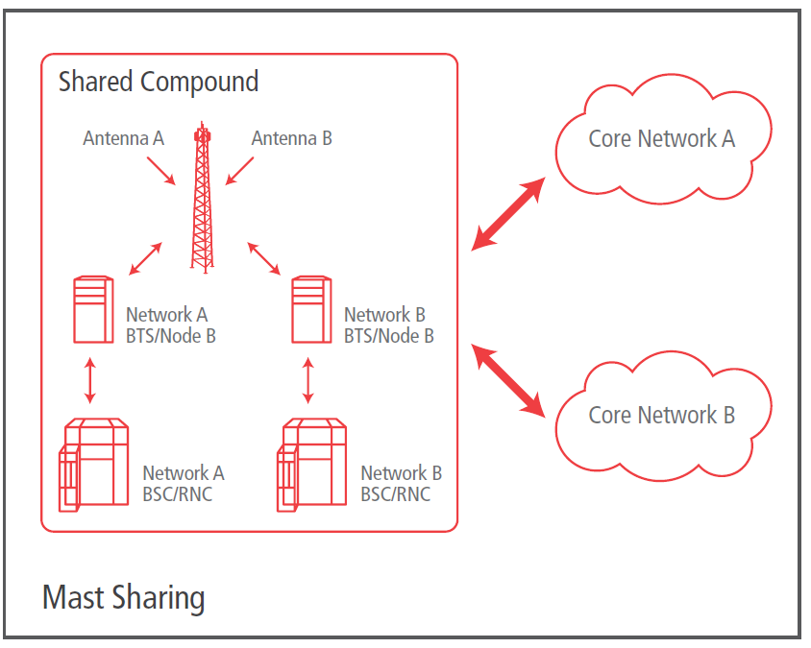
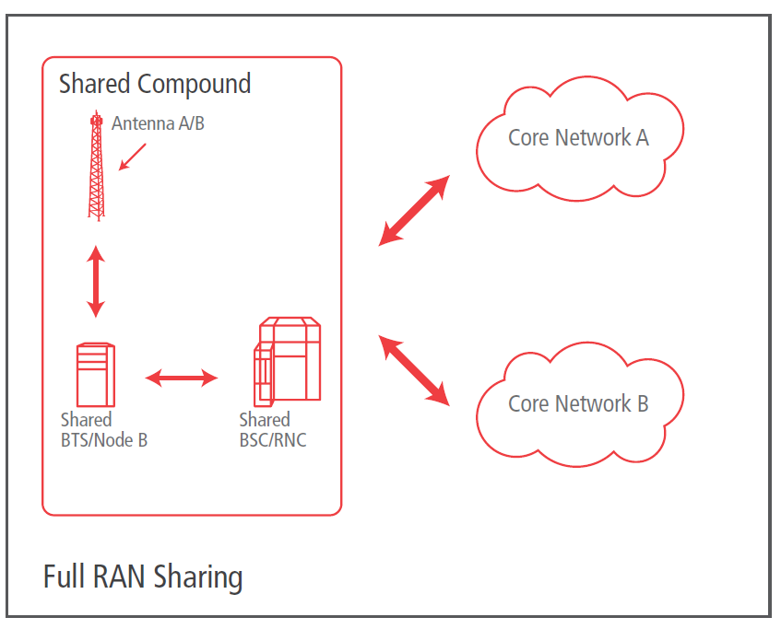
MEETING THE GROWING DEMAND
INFRASTRUCTURE SHARING
Regulatory framework should facilitate operator’s engagement in voluntary active and passive infrastructure sharing between operators.
MAST SHARING
Mast, or tower, sharing is a step up from operators simply co-locating their sites and involves sharing the same mast, antenna frame or rooftop.
RAN SHARING
RAN sharing involves the sharing of all access network equipment, including the antenna, mast and backhaul equipment.
Each of the RAN access networks is incorporated into a single network, which is then split into separate networks at the point of connection to the core.

Slide 19

BENEFITS OF RELEASING HARMONISED SPECTRUM

Slide 20

MEETING THE GROWING DEMAND
IMPORTANCE OF HARMONISATION
AFFORDABILITY
economies
of scale
Brings down the cost of mobile devices
MOBILE
SPECTRUM
Enables people to roam
CHOICE
competition
Reduces interference issues along borders
ROAMING
harmonised
bands
The allocation of harmonised spectrum to mobile directly contributes to the development of the industry, as well as promote the development of broadband internet, which is central to economic and social development.

Slide 21
IDENTIFIED SPECTRUM BANDS
The benefits of bandwidths below 1GHz are crucial for the deployment of the mobile broadband
Ideal for the deployment of mobile broadband over large areas, especially in rural areas
Coverage Bands (<1GHz)
TO BE CONFIRMED IN 2015
703
733
758
788
25
MHz
The 700 band: 2x30 MHz
Improve saturation in urban areas and enhance building penetration
791
821
832
862
11
MHz
The 800 band: 2x30 MHz
The 700MHz band increasingly used across the globe for mobile broadband services
880
915
925
960
10
MHz
The 900 band: 2x35 MHz

Slide 22
IDENTIFIED SPECTRUM BANDS
High-frequencies shall be dedicated to offering additional capacity in urban areas
Capacity Bands (>1GHz)
Limited coverage as the radio signals are weakened or even stopped by obstacles such as buildings
1710
1785
1805
1880
20
MHz
The1800 band: 2x75 MHz
Strong capacity capabilities due to greater availability of this spectrum
1920
1980
2110
2170
30
MHz
The 2100 band: 2x60 MHz
2500
2570
2620
2690
Create broad frequency bands allowing more information to be carried
TDD
The 2600 band: 2x70 MHz with 50 MHz unpaired TDD

Slide 23
Releasing additional spectrum
Governments in the Arab States can avoid this spectrum scarcity:
By releasing harmonised spectrum in the Digital Dividend bands (700MHz and 800MHz)
By promoting spectrum liberalisation by refarming the 1.8GHz band
By promoting further release of the 2.6GHz band
Traffic projections for the Arab States with additional spectrum
Impact on mobile broadband connections in the Middle East and North Africa
^{Source: Deloitte}
^{Source: Deloitte}
If spectrum were made available in a harmonised manner, data consumption could grow 25-fold between 2015 and 2025
The impacts can be estimated for 2015–2025
In North Africa an average increase in GDP per capita growth of 4.4% is forecasted
The Middle East would see an increase of 2.5%

Slide 24
SUMMARY
Data demand continues to grow
Making additional spectrum available to the service that offers the greatest benefits to society
Facilitating international harmonisation to support roaming and scale economies that lower the cost of equipment
Licensing issues are critical
Removing unnecessary restrictions on the use of spectrum, including allowing for new mobile technologies
Ensuring a fair and predictable licensing environment, which facilitates the investments required to take full advantage of a country’s spectrum resources
Benefits from Additional Spectrum for Mobile Broadband
Maximising the benefit of bands below 1GHz to deliver mobile broadband
Complemented for capacity with 1800 MHz, 2.3 GHz and 2.6 GHz
703
733
758
788
791
821
832
862
880
915
925
960 MHz
700 MHz
800 MHz
900 MHz

Slide 25
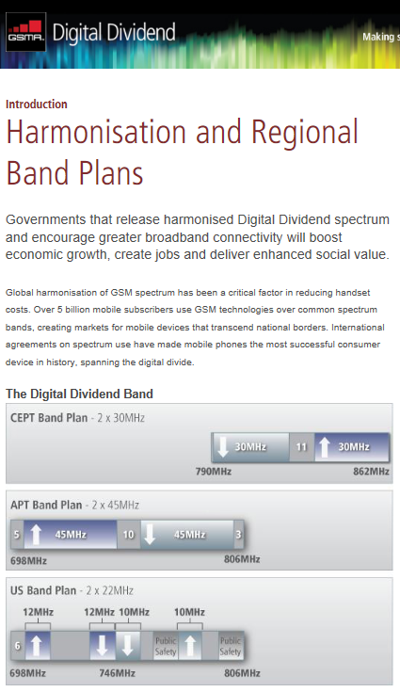

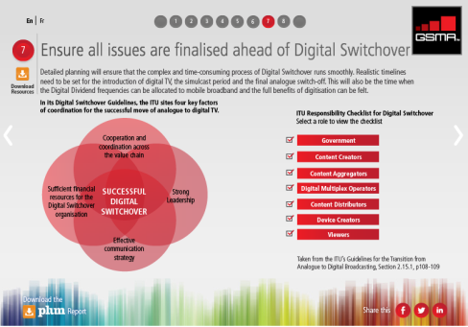
GSMA RESOURCES
Digital Dividend Toolkit
www.gsma.com/digitaldividendtoolkit
An online resource offering the latest policies, perspectives and best practices for securing and implementing Digital Dividend spectrum
for mobile broadband.
Digital Switchover Guide
www.gsma.com/spectrum/digital-switchover
An interactive tool that describes how to manage the conversion to digital television
and release Digital Dividend spectrum
for mobile.
Mobile Policy Handbook
www.gsma.com/publicpolicy/handbook
A portal to GSMA positions on mobile policy issues, including spectrum management and licensing.
GSMA Spectrum Resources
www.gsma.com/spectrum/resources
Our library of research, reports, case studies and collateral.

Slide 26
THANK YOU

