Slide 1

15th Annual Meeting of the Arab Network for ICT Regulators (ARGENET)
Workshop on 5G and its Impact.
Abu Dhabi, UAE
18 September 2017
The 5G era
Age of boundless connectivity and intelligent automation
© GSMA and GSMA Intelligence; 2017

Slide 2
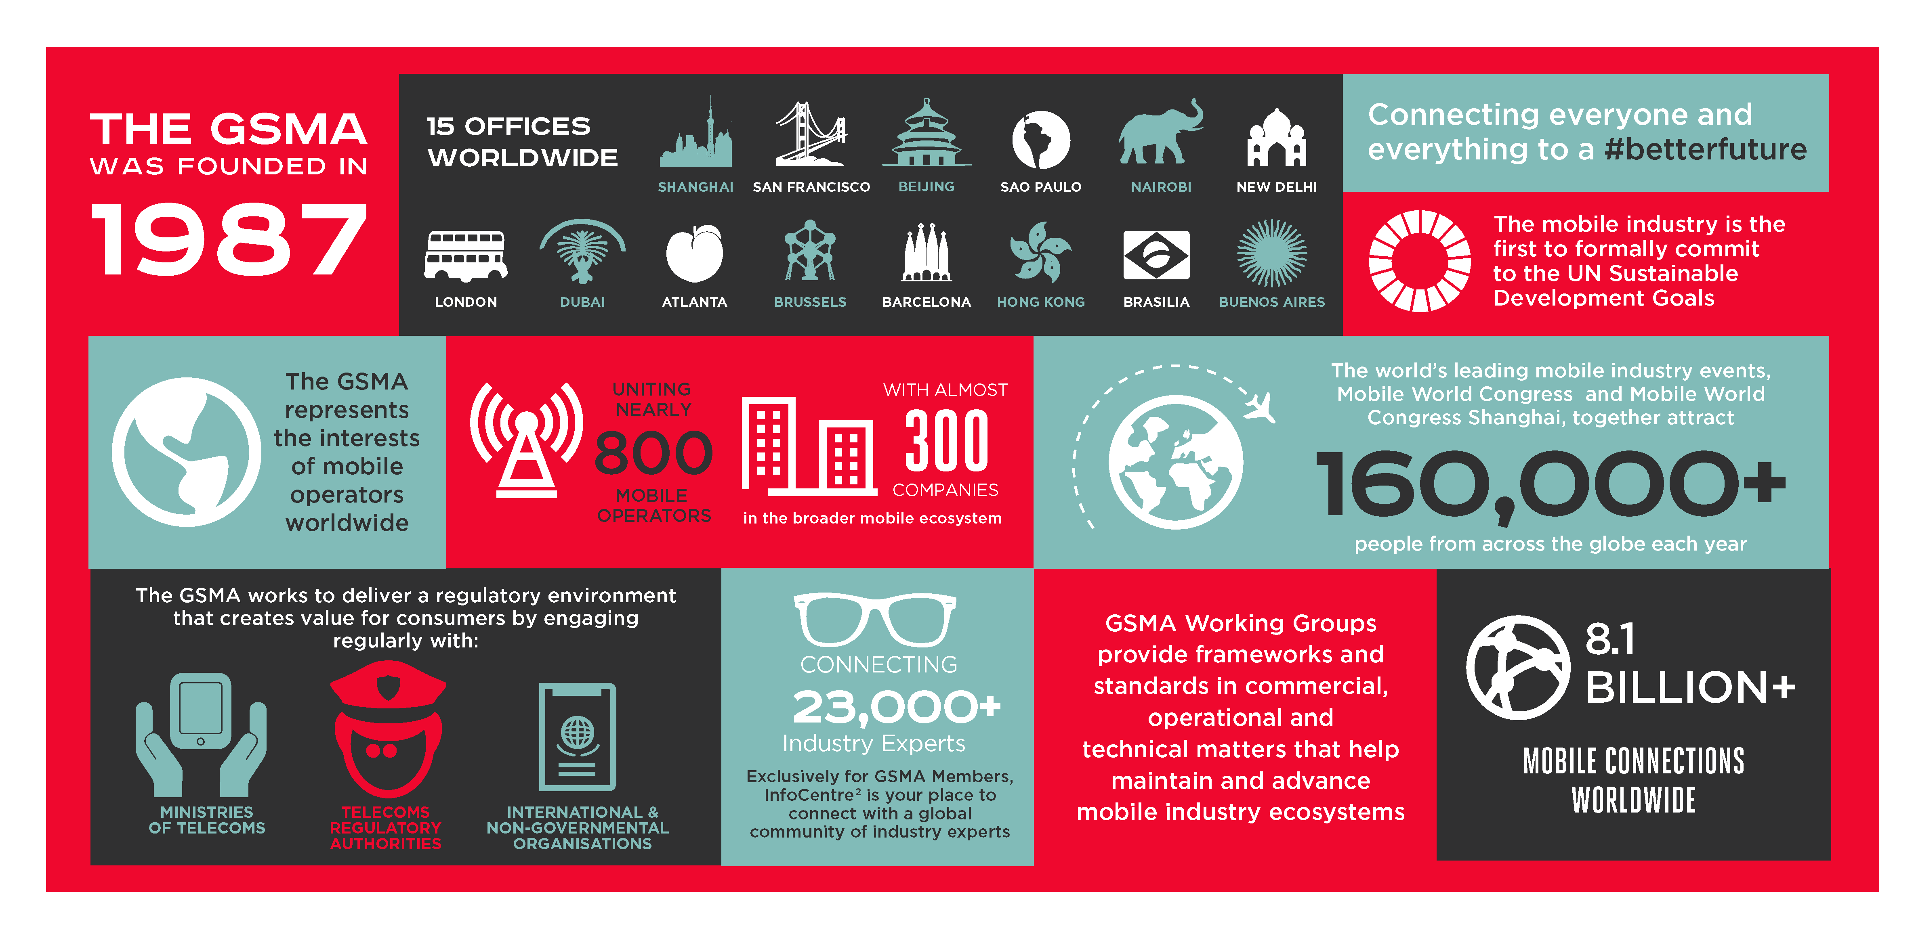
About the GSMA

Slide 3

We can begin to imagine the future with 5G…
Industrial digitisation & automation drives
GDP growth to 5%
“….. Economists predict that the trend will continue as the full scale of the 5G Internet of Things explosion is only just beginning to come through …”
Scientists announce breakthrough in
human-to-machine communication
“….. experts expect the computers to be linked to users’ personal cloud storage via 5G networks, enabling each user to capture, process, upload and store their daily emotions…”
Hackers go on shopping spree with 10 million
hacked avatar assistants
“….. it is important that avatars are registered with the home 5G small cell gateway to ensure that avatars are protected by the robust security features of 5G …”
A billion postal deliveries signed for
via augmented reality
“….. Away from Home, which is available to customers with a 5G device, enables customers to confirm and remotely sign for their parcel using augmented reality…”
Hypothetical future news headlines: March 2027

Slide 4
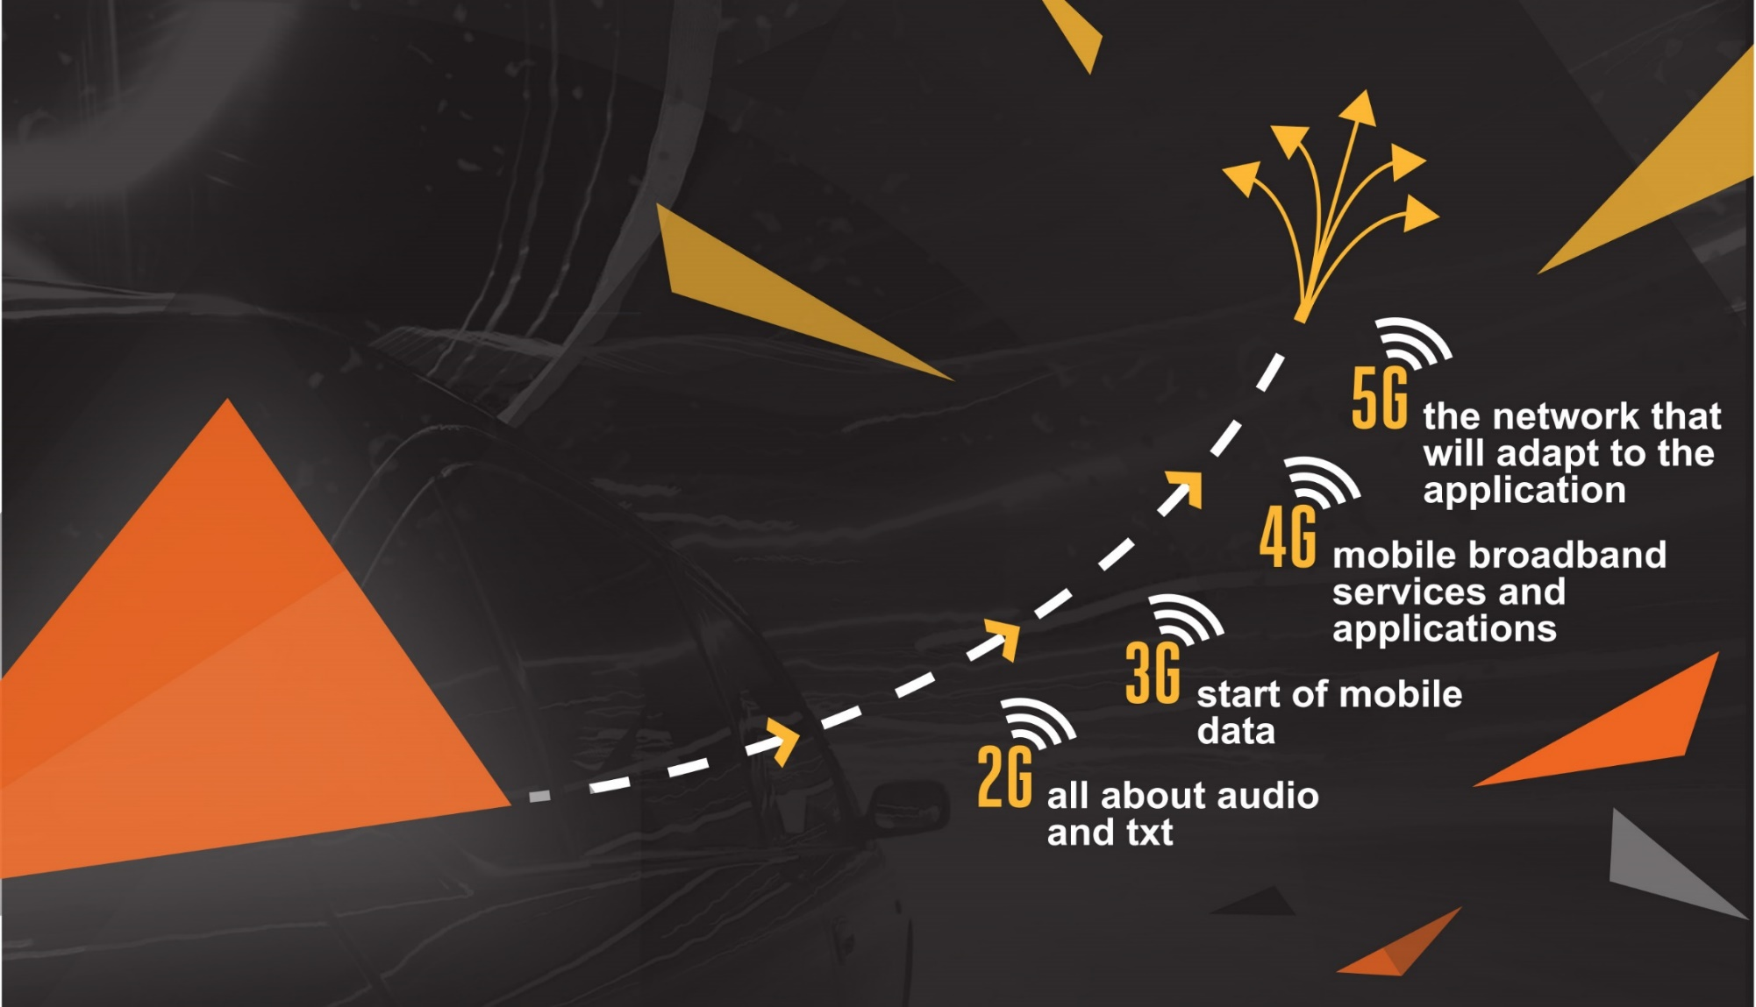
… and see that 5G is on the horizon …
The
story

Slide 5
… but there are so many questions and concerns about 5G
What is the business case for 5G?
Show me a compelling 5G use case?
Bigger, faster broadband is not exciting enough!
Who is going to pay for new 5G networks?
4G is enough. No one needs 1Gbps or 1ms!
No 5G unless Net Neutrality is relaxed!
5G for rural customers is an oxymoron
Why should operators pay for 5G for OTTs?
Massive IoT is irrelevant. We have NB-IoT
Not exhaustive

Slide 6


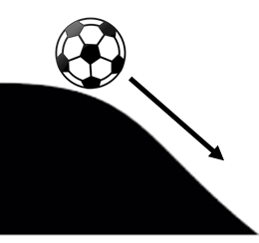
Our paper tries to address the questions and concerns to enable 5G to become a growth story for our industry
3
New sources of revenue growth
2
Efficient network rollout & management
Drive growth in the enterprise segment with B2B & B2B2C models
Sustain the consumer segment with new services, enhanced capabilities & new business models
1
Unstoppable technology evolution
Support technology & spectrum policies to lower cost of networks
Consider new models of infrastructure ownership, partnerships and sharing
Positively embrace 5G as the next phase of technology evolution
Plan for 5G and how to make it a success story

Slide 7

We sought our members views to develop a vision for the 5G Era…
In October 2016 we asked the CEOs of our 750+ mobile operator members 20 questions (CEO 5G Survey)
And derived 10 insights…
1
5G will transform the mobile broadband experience in early deployments and drive new intelligent automation use cases later.
6
Competition and collaboration between operators and other
ecosystem players to provide services will intensify in the 5G era.
2
5G as a technology will evolve over time and leverage a variety of spectrum ranges, plus robust security, to support new use cases.
7
New models for infrastructure ownership, competition and
partnerships will be required for the 5G era.
3
Enterprise services and solutions will drive 5G’s incremental potential.
8
Regulation, licensing and spectrum policy will make or break the 5G opportunity.
4
5G will start as an urban-focused technology and integrate with 4G to provide boundless connectivity for all.
9
The industry should strive to avoid spectrum and technology fragmentation for 5G.
5
5G will deliver revenue growth to mobile operators, with a 2.5% CAGR in the early 5G era.
10
Interoperable and interconnected IP communication services, including device-to-device, supported as default in the 5G era.
Full details are in the paper “The 5G era: age of boundless connectivity and intelligent automation”

Slide 8
… and modelled the growth of 5G connections to understand how the market will evolve …
1.1 billion 5G connections
34% 5G population coverage
Scope
Only eMBB connections. Excludes cellular IoT and fixed-wireless access
Methodology
Models network rollout based on LTE rollout and adoption
Takes account of changing population trends

Slide 9
… and then explored how 5G can support operators to drive incremental revenue growth
2.5% CAGR
2.0% CAGR
Methodology
Based on feedback from the CEO 5G survey, and other GSMA Intelligence datasets
Forecast projects increased returns within early 5G era as operators drive incremental revenues from the enterprise segment

Slide 10
Based on the insights, and the forecasts, the GSMA developed the industry goals for the 5G era
Boundless connectivity for all
1
Vertical / Industrial Transformation
Network Economics & Innovation
5
2
5G era Goals
Massive IoT & Critical Communications
4
3
Enhanced Broadband

Slide 11







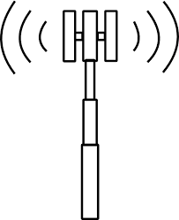













Goal 1: Provide boundless connectivity for all
1
5G networks will co-exist with 4G networks and relevant alternative network technologies
Aerial networks
Cloud
Alternative Networks
5G + 4G
5G + 4G
5G + 4G
LPWA
LPWA
ADSL/FIBER
Together they will be used to deliver a boundless, high-speed, reliable and secure broadband experience, and support a plethora of use cases for society.

Slide 12
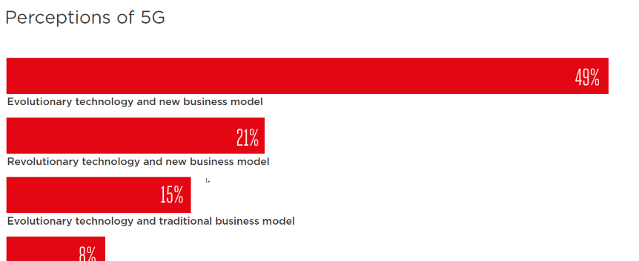
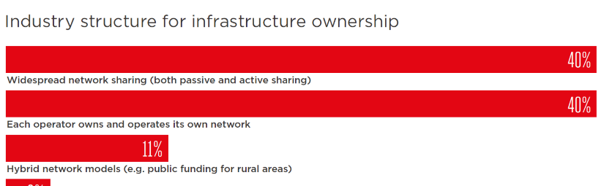
Goal 2: Deliver future networks innovatively and with optimal economics
2
All stakeholders will strive to cost-effectively deliver better quality networks in the 5G era
Future networks will…
Rely on a combination of mainstream and alternative technologies
Built independently or via partnerships
Use both licensed and unlicensed spectrum
Operate across different spectrum bands
Evolutionary technology supporting new business model
Security
Partnerships playing a vital role
Source: CEO 5G survey

Slide 13
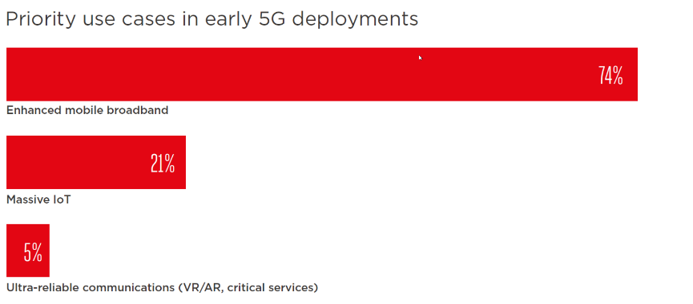
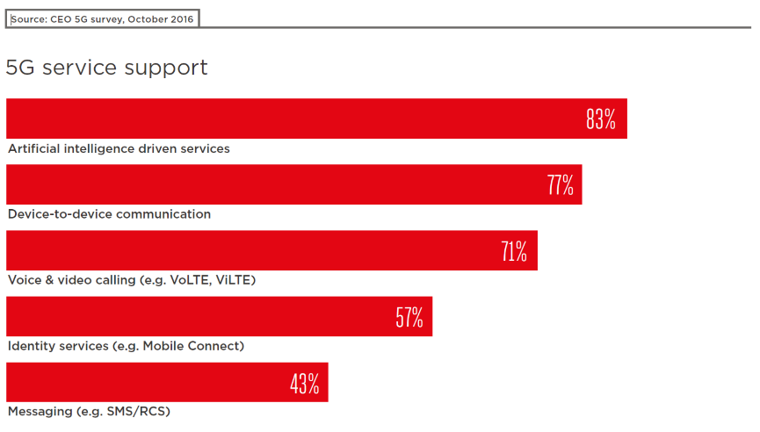
Goal 3: Revolutionize the mobile broadband experience
3
5G networks will provide an enhanced broadband experience of up to 1 Gbps throughput and <10 milliseconds latency
Broadband is king: Enhanced mobile broadband is a clear winner for early deployment
5G will provide the platform for cloud-based and artificial intelligence-based services.
Source: CEO 5G survey

Slide 14


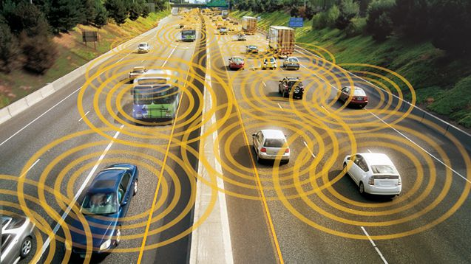
Goal 4: Help to grow new IoT & critical communications use cases
4
5G networks will support the massive rollout of intelligent IoT nodes and provide a for the widespread adoption of critical communications services
Device to device becomes mainstream; From Internet of things to Internet of Everything;
Critical Communications pervade society

Slide 15






Goal 5: Accelerate the digital transformation of vertical industries
5
The mobile industry will provide the networks and platforms to drive the digitisation and automation of industrial practices and processes
LOGISTICS
SMART TRANSPORT
ULTRA RELIABLE COMMUNICATIONS
INDUSTRIAL APPLICATIONS
Augmented Reality
AGRICULTURE APPLICATIONS

Slide 16
The GSMA will continue to play a crucial role on the road to 5G
Influence
Technology & Standards
Support
Guide
Rollout & new business models
GSMA’s
5G era role
Policymaking
Moderate
Advocacy & messaging

Slide 17
Our paper presents the industry’s 5G era story, vision and goals and these will be developed further in other GSMA 5G activities
Key question on 5G
5G era vision paper
Follow on GSMA activities
Regional 5G position papers
What should the industry do about 5G?
The 5G era: age of boundless connectivity and intelligent automation
5G spectrum & policy landscape
5G business principles
5G technology drivers
Other GSMA 5G activities

Slide 18


Thank You
Download the report
https://www.gsmaintelligence.com/research/?file=0efdd9e7b6eb1c4ad9aa5d4c0c971e62&download

