Slide 1
Introducing IMT-2020 (5G) in the Arab Region

Slide 2
Evolution of Mobile
Industrialization
Automation
Connected Life
1980
1990
2000
2010
2020
2030
Voice
R&D
1G – TACS. AMPS
Digital
R&D
2G – GSM/GPRS/EDGE. DAMPS/CDMA
Data
R&D
3G – WCDMA/HSPA. CDMA1x/EVDO
IP
R&D
4G – WiMAX. LTE/LTE Advanced
IoE
?
R&D
5G – …
Connections
? Billion
0.5 Billion
1.5 Billion
6.5 Billion
8.9 Billion
50 Billion
Source: CISCO
Notes:
"In 1980, McKinsey & Company was commissioned by AT&T (whose Bell Labs had invented cellular telephony) to forecast cell phone penetration in the U.S. by 2000. The consultant’s prediction, 900,000 subscribers, was less than 1% of the actual figure, 109 Million. Based on this legendary mistake, AT&T decided there was not much future to these toys. A decade later, to rejoin the cellular market, AT&T had to acquire McCaw Cellular for $12.6 Billion. By 2011, the number of subscribers worldwide had surpassed 5 Billion and cellular communication had become an unprecedented technological revolution." Source: A blog post by Professor Angel Lozano, retrieved 21st July 2014 www.dtic.upf.edu/~alozano/innovation/

Slide 3
Evolution of Internet
Immersive
Experiences
Digitize Interactions (Business & Social)
Internet of Everything
Digitize the World
Networked Economy
Digitize Business Process
Connectivity
Digitize Access to Information
Connecting:
People
Process
Data
Things
Social
Mobility
Cloud
Video
E-commerce
Digital Supply Chain
Collaboration
Email
Web Browser
Search

Slide 4
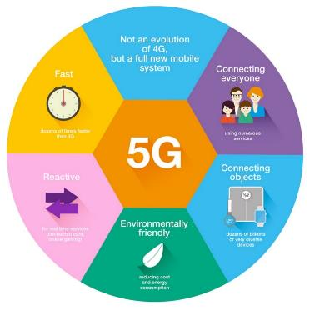
IMT-2020 (5G) Vision
Services
Ubiquitous bandwidth (no more cell edge)
HD video everywhere (up and down)
Internet of Everything (M2M, M2P & P2P)
Sensing, Presence and Ad-hoc networking
Web eco-system of Apps and Services
Technical Requirements
1. Higher System Capacity
1000x capacity/km2
2. High Data Rates
10-100x current 4G rates
3. Lower Latency
Below 1ms
4. Mass Connectivity
100x connected devices
5. Energy Efficient
10x Network and Device power savings
6. More Agile
10x faster time-to-market

Slide 5
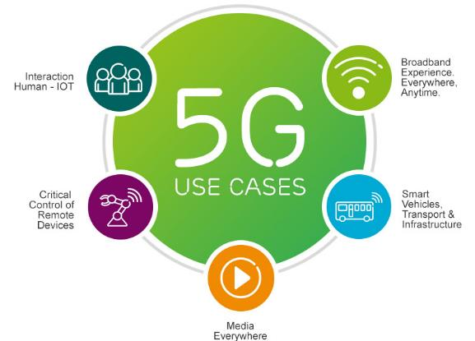
IMT-2020 (5G) Pillars & Use cases
Spectrum
Verticals
Network

Slide 6
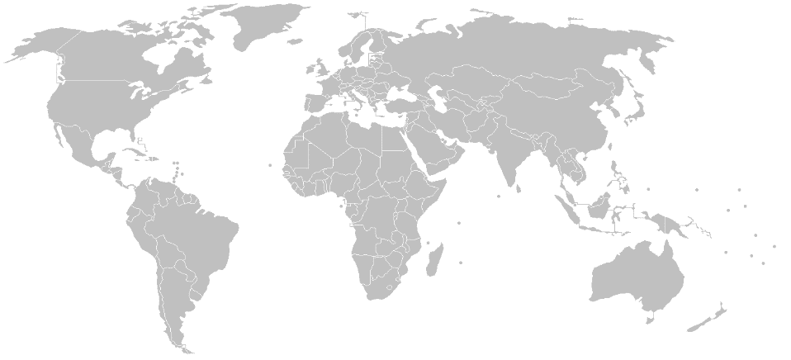
IMT-2020 (5G) announcements
World Cup 2018
Pre-Commercial
EU2020
Commercial
Olympics 2020
Commericial
2017
Pre-Commercial
（28, 39GHz）
2020
Commericial
Verizon 2017 Pre-Commercial
（28GHz）
2020 Expo
Commercial
Winter Olympic 2018
Pre-Commercial
2018
Pre-Commercial

Slide 7
Global IMT-2020 (5G) efforts
5G PPP - EU
5G MF - Japan
5G Forum - Korea
5G Group - China
To secure Europe’s leadership in 5G
Under Horizon 2020
Budget of € 700 million
To secure Japan’s leadership in 5G
108 members
Advisory Board & 4 Tech Committees
To secure Korea’s leadership in 5G
32 members
Steering Committee & 5 Tech Committees
To secure China’s leadership in 5G
1 Experts Committee & 9 Tech Committees
Tech & System Trials
5G – USA FCC
5G – ACMA
5G – Turkey
5G - UAE
Announced as Initiative
'The Future of Wireless: A Vision for U.S. Leadership in a 5G World”
Consultation
Commercial by 2020
Telstra
Turkish 5G Forum (5GTR)
Implement 5G vision
5G Roadmap for Turkey
1 Steering Committee & 3 Tech Committees

Slide 8
Areas of work
Spectrum
Frequency Bands
Compatibility Studies
Standards (ITU, 3GPP, ETSI, 5GPP, 5GMF)
Use cases
1
Network
IOT, V2X
Incubation Hubs
Academia
E-Health, E-Agriculture
NGMN, NET2020
Access & Backhaul
Cloud, Data, Privacy
Trials, Readiness
2
3

Slide 9
IMT-2020 (5G) Roadmap
2016
2017
2018
2019
2020
Roadmap Plan
Establish Committees
Establish Scope of Work
Working Group work
Action Plan
Spectrum
Use cases
Trials
MOUs
Use cases
PP-18 Demo
IMT-2020 AI eval.
Stds.
Net 2020
Korea Precomm 5G
Use cases
Rel-15
Operators readiness
WRC-19
Eco Sys Readiness
Network upgrades
Deploy 5G
User trials
Launch 5G
Expo 2020
Japan 2020

Slide 10
Challenges
700 MHz allocation
3.4-3.6-3.8 GHz allocation
Other bands < 6 GHz
WRC-19 AI 1.13 bands
Compatibility with Satellite
28 GHz, Harmonization
Use cases not known (IOT, V2X)
Diverse stakeholders (Vendors, Users, Entities, Intl. Orgs)
Standards Dev (IMT, Rel-14)
Risks of being first
Budget & Support
Network 2020, NGMN
Trials, Readiness
Data, Privacy, Cloud

Slide 11
WRC-19 Agenda Item 1.13
“to consider identification of frequency bands for the future development of International Mobile Telecommunications (IMT), including possible additional allocations to the mobile service on a primary basis, in accordance with Resolution 238 (WRC‑15)”
ASMG Position:
Support initiating studies in the frequency bands listed below, which are included in Resolution 238 (WRC 15):
24.25 - 27.5 GHz
31.8 - 33.4 GHz
40.5 - 42.5 GHz
42.5 - 43.5 GHz
Not supporting discussing any study or contribution on the frequency bands which are not included in Resolution 238 (WRC 15) in the work of Task Group 5/1 (TG 5/1).

Slide 12
شكرا

