Slide 1
Workshop on 5G and its Impact 15th Annual Meeting of the Arab Network for ICT Regulators (ARGENET) Abu Dhabi-UAE, 18 Sept. 2017
IMT-2020/5G:
ITU-T SG13
Contribution to 5G ITU/TSB

Slide 2
Content
IMT-2020 in SG13: the commitment
WP1: structure, workplan and objectives
Internal process and external relationships
Focusing deliverables: Technical Packages
Conclusions

Slide 3
IMT-2020: the 5G challenge in ITU
5G, a multidirectional evolution:
New Radio and always improving fixed access
Backhaul and fronthaul technologies to support massive mobile and Ultra-BB on any access
New Core and architecture
Cloud becomes an integrated element of the network to host it functions
All always connected: IoT, V2X…
All the areas of study of ITU are involved
IMT-2020 Network in SG13:
how ITU starts addressing 5G network challenge:
FG IMT 2020 for pre-standard studies
Creation of WP1 to
address IMT2020 network requirements and architecture in 2017-20
Focus on fixed line access and transport aspects
Prepare the ground for following protocol specifications in other SG

Slide 4
WP1/13 Structure
Who does what on IMT-2020
Question | Title
Q6 | Quality of service (QoS) aspects including IMT-2020 networks
 | Continuation of Q6/13 from the last study period
Q20 | IMT-2020: Network requirements and functional architecture
 | New Question Transformation from Architecture WG of FG IMT-2020
Q21 | Network softwarization including software-defined networking, network slicing and orchestration
 | Continuation of Q14/13 and 12/13 from the last study period Transformation from Softwarization WG and Network Management WG of FG IMT-2020
Q22 | Upcoming network technologies for IMT-2020 and Future Networks
 | Continuation of Q13/13 and 15/13 from the last study period Transformation from ICN WG of FG IMT-2020
Q23 | Fixed-Mobile Convergence including IMT-2020
 | Continuation of Q4/13, 9/13 and 10/13 from the last study period Transformation from FMC WG of FG IMT-2020

Slide 5
Q6 Delivery plan for WP1 IMT-2020
Activity and documents in progress
Document (for Recommendation) on QoS monitoring for IMT-2020 in plan (07/2018)

Slide 6
Q6 work items

Slide 7
Q20/13 Delivery plan for WP1 IMT-2020
Activity and documents in progress
Terms and definitions 07/2017
General Requirements 11/2017
Framework 11/2017
Architecture 2018
Network capability exposure requirements 2018
(in Q20 or in Q21)
Requirements are considered the most urgent WI to be completed

Slide 8
Q20/13 WI (delivery in July highlighted)

Slide 9
Q21/13 Delivery plan for WP1 IMT-2020
Activity and documents in progress
TR (supplement 44 to Y.3100-series) on standards and Softwarisation (07/2017)
Recommendation on High level characteristics/requirements on key aspects of softwarisation (11/2017)
Recommendation on IMT-2020 network management and orchestration req (07/2017)
Framework for IMT2020 network management and orchestration (07/2017)
Further Softwarisation aspects in 2018
Dependencies on the general Requirements (Q20) will need to be taken care of asap while work is progressing

Slide 10
Q21/13 WI (delivery July highlighted)

Slide 11
Q22 Delivery plan for WP1 IMT-2020
Activity and documents in progress
Focus on ICN
One Rec consented in February Y.3071
One WI from the input document from the FG
Alignment with FMC is important
Requirements for 1st H 2018
Harmonisation with General Requirements (Q20) and other specific requirements will need to be taken care of asap while work is progressing

Slide 12
Q22/13 work items

Slide 13
Q23 Delivery plan for WP1
Activity and documents in progress
Recommendation on requirements for FMC (11/17)
Recommendation on FMC high level architecture (early 2018)
Some work on mobility management
Harmonisation with General Requirements (Q20) and other specific requirements will need to be taken care of asap while work is progressing

Slide 14
Q23/13 work items

Slide 15
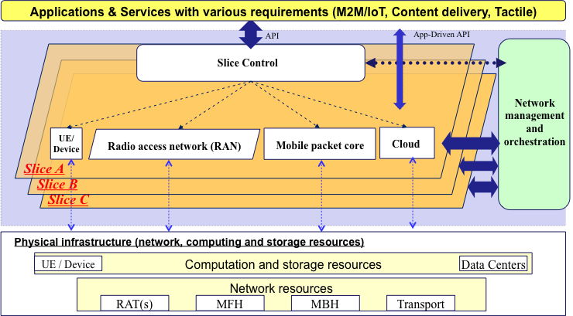
One of the most complex aspects in IMT-2020: Slicing

Slide 16
(REAL)Collaboration is fundamental: inside…
Work and deliverable organisation according to Technical Packages to offer the market greater benefits
Joint meetings and
cross - fertilisation
Technical Packages
They are more than the simple sum of differentr documents
Synchronise recommendations and TRs according to the technological area (slicing, FMC, ICN …)
Prioritise the most important areas
Join forces between different questions and work together as needed
SLICING an FMC are the TP which we are working on so far
Almost 30 incoming liaisons per meeting: collaboration is essential!....

Slide 17
Conclusions
IMT-2020 is attractive and challenging
Every SDO and innumerable projects and fora work on it
Need to avoid the overlap risk
5G is an immense field of development
Select and prioritise what can be done effectively
Keep coherence under control: WP1 Technical Packages
Cooperation is essential
Between different Qs in the same WP
With other SGs and external entities
Go beyond the usual very formal LS exchange with, in too many cases, little real cooperation
Try to adapt in terms of timing and work schedule also with other groups
Notes:
Ardeche Bio
Ardeche wool
Other communities in spain, germany, all over the world
Sell on the web
Use IoT as well
Fun and useful
Money and ethic
Can it help to save us

