Slide 1
Cyber Security Issues and Challenges
Roger Cressey
Sharm el Sheikh, Egypt
April 12, 2012

Slide 2
At Booz Allen, we focus on delivering results for clients in over 40 countries across multiple domains
Who We Are ...
What We Do ...
One of the oldest, largest and most experienced strategy and technology consulting firms
  Founded in 1914
  25,000+ professionals
  $5 Billion in Annual Sales
Our business model is driven by global industry practices emphasizing industry expertise to better serve clients
We bring a global perspective — have served clients in over 40 countries
We are not aligned with any other integration firms or software vendors – we bring an objective and independent viewpoint to all of our clients
With deep expertise in both strategy and technology, Booz Allen transcends conventional categories of consulting
Booz Allen teams work together with clients to help them succeed...
…through the continual interplay of insight and action
Producing results that endure tomorrow
Booz Allen delivers end-to-end strategy-based transformation solutions through multi-disciplinary skills…
… and through our industry expertise which spans virtually every major industry sector
Mission: Booz Allen combines strategy with technology, and insight with action, working with clients to deliver results today that endure tomorrow

Slide 3
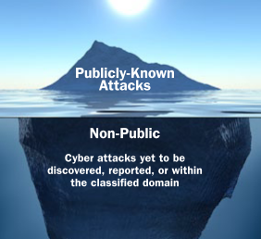
The significant increase in the sophistication and frequency of cyber attacks (public and non-public) presents material risks to organizations
Cybersecurity Risk Landscape
Most organizations are only prepared to handle a fraction of actual security concerns
Threat Sources
Vulnerabilities
Unprecedented Risk
Hyper-interconnectivity of information systems
Rapid technological infrastructure expansion
Undefinable business perimeter
Unprepared corporate workforce and culture
Dissimilar security models applied across the enterprise
Intellectual property theft
Monetary losses
Operational disruptions
Company devaluation
Customer suits
Media publicity
Brand degradation
Environmental issues
Regulator intervention
Insiders
Criminals
State Actors
Hacktivists
Individuals
Representative Attacks
Lockheed Martin (2011)
Perpetrators infiltrated major network linked to Departments of Defense and Homeland Security
RSA (2011)
Alleged nation-state attack against SecurID tokens victimized over 760 companies worldwide
Citibank (2009)
Computer-security breach targeting Citigroup that resulted in a theft of tens of millions of dollars
Night Dragon (2011)
Covert and multidimensional cyber attacks conducted against global oil, energy, and petrochemical companies; endangers critical infrastructure

Slide 4
A variety of cyber threat actors have emerged over the recent years that target the vulnerabilities across cyber programs worldwide
High (APT)
Low
Threat Sophistication
Actors | Individuals/Amateur Hackers | Hacktivists (e.g. Anonymous, LulzSec) | Cyber Criminals | Insiders | Nation-states
Capabilities | Website defacement, Denial of Service (DoS), Phishing scams | Website defacement, Distributed Denial of Service (DDoS), web-based attacks , SQL injection | Viruses, worms, trojans, malware, botnets, web-based attacks | Physical access to transmit, download, or copy information | Remote access tools (RAT), custom exploits, spear-phishing, zero-day exploits
Intentions | Indiscriminately selected companies and/or organizations | Selected company and organizations’ operations, brand, and reputation | Personally Identifiable Information (PII) (e.g. SSN’s, credit card numbers, health records), proprietary information | Trade secrets, proprietary, sensitive, or classified information | Trade secrets, proprietary, sensitive, or classified economic and/or national security information
Consequence | Nuisance, disruptions of business operations | Disruption of business operations, reputational loss | Customer financial loss, company financial loss, reputational loss, lost productivity | Loss of economic competitive advantage, increased foreign competition | Loss of national economic competitive advantage, increased foreign competition, loss of national security secrets
Estimated Loss¹ | — | $171 million (single case) | $5.9 million per year per organization | $20 million (single case) | $2-$400 billion
(1) Costs are UNITED STATES ONLY and based on disparate data, individual cases studies, and broad estimates
Sources: “Foreign Spies Stealing US Economic Secrets in Cyberspace.” Office of the National Counterintelligence Executive. October 2011 ; “Second Annual Cost of Cybercrime Study.” Ponemon Institute. August 2011; “Sony Data Breach Cleanup to Cost $171 Million.” Information Week. May 23, 2011.

Slide 5
APTs constitute a mature attack and introduce a new paradigm of cyber security threats
Basic
Advanced
APTs
Examples:
Generic phishing scams
Attacks against organizations with little-to-no security – weakest in the heard/opportunistic approach
Cyber techniques available on internet/open source
Types of Attackers:
Amateur hackers
Scam artists
Examples:
Distribute Denial of Service
Targeted private data extraction
Extortion as motive
Customized tools
Developed techniques
Types of Attackers:
Extortionists
Mature cyber criminals
Examples:
Highly sophisticated adversaries who can bypass virtually all of today’s “best practice” security controls
Primary goal is long-term, persistent occupation for data theft, intelligence espionage, and other malicious activities
Types of Attackers:
Nation states
Sophisticated adversaries
Maturity Level
Simple, easily accessed tools, done by amateur hacker and not particularly targeted
Technical mature, developed by
advanced individuals or teams,
but not coordinated or extremely targeted
Sophisticated, planned
over long-periods,
complex, and targeted

Slide 6
Because APTs are targeted at one specific organization, they must be treated as a primarily agent-oriented (people) problems
APTs Differ from Traditional Threats in Two Significant Ways
APTs are Persistent (Targeted )
APTs are Advanced
Underlying cause of APTs is desire to acquire assets from or disrupt a single organization
Because of high cost of mounting an APT attack, only large, highly-influential organizations are typically targeted
  Target of high strategic value to attacker
  Attackers typically well-funded, organized
Attackers will not use commodity attacks: will find and breach any potential vulnerability
  Many APT entry-points are social in nature
Must consider APTs as an actor threat requiring a comprehensive mitigation strategy
Because attackers are interested in breaching a specific organization regardless of cost, most technological attacks are highly-customized
  Attacks tend to be over multiple vectors and sometimes crafted around 0-day exploits
  Traditional signature-based detection (AV and IDS), are generally ineffective
Given a breach, because APTs are agent-oriented threats, simply patching the technology is insufficient
  If organization remains unhardened, attacker will simply craft new payload
  Traditional cyber security focuses mainly on technological vulnerability, not the attacker: will not work for APTs
Because attackers are persistent during an APT, attacks are advanced (i.e. many vectors, complex)

Slide 7
APTs make a significant investment in their target and will vary and escalate their techniques and not move on to another victim
Notional APT Approach
Network Compromised
Adversary collects non-traditional attack information
The adversary creates a highly socialized, targeted e-mail message that potentially contains previously unknown malicious code – spear phishing
If phishing attempt successful, the adversary immediately connects to the victim’s workstation
The adversary will quickly install additional channels to ensure access to the internal network
The APT will quickly entrench themselves at the enterprise level
Data is collected and exfiltrated from the network
There is no “typical” APT approach…
attackers will keep trying
until they gain network access
Your opponent is a determined individual or organization, not a technology
Notes:
Completely redo

Slide 8

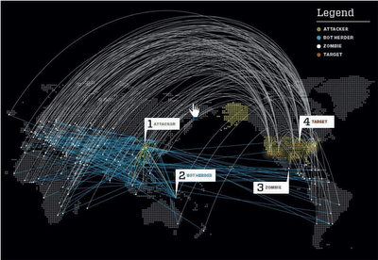
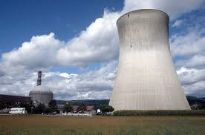
Organizations with sensitive data need to be especially wary of APTs: marginal improvements in traditional security are not enough
Target
Motivation
Result
2008: Large Oil Companies
Attackers sought valuable data about new discoveries of oil deposits (this data can cost hundreds of millions of dollars to produce)
Companies unaware of extent of attack until alerted by FBI; APTs had been persistent since 2008 and actively exfiltrating e-mails and passwords of senior executives
2010: Sophisticated
Technology Companies
Chinese attackers successfully exfiltrated sensitive data from Google, Adobe, Yahoo, Dow Chemical, and Symantec (a leading manufacturer of computer security products) servers
Attackers sought persistent access to cutting-edge intellectual capital
2010: Stuxnet
Attackers successfully infiltrated several nuclear sites and damaged uranium enrichment facilities
Cited as one of the most refined pieces of malware ever discovered, experts believe only a nation state would be able to produce it
Attackers sought to disrupt critical industrial infrastructure, specifically targeting nuclear facilities

Slide 9
Because of the high level of sophistication, traditional cyber remediation techniques are insufficient to address the technological risks posed by APTs
Traditional Remediation Techniques Under APTs
 | Traditional Remediation on Traditional Threats | Traditional Remediation on Advanced Persistent Threats
Password Reset | Attackers have procured user passwords and have active access to user accounts Password reset removes access to accounts | Password reset temporarily removes access to accounts Attackers utilize shared accounts to discover changed passwords Attackers have active access to user accounts again
Anti-Virus | Attackers have planted common attack vectors on organization computers Anti-viral software detects and removes such vectors | Anti-viral software unable to detect custom-created exploits APTs require custom-crafted detection and removal solutions
Network Security | Organization enacts strict firewalls and network security to exclude external traffic Internal access controls prevent wide data breaches | APTs planted internally already open holes through firewall and network security Attackers have access to user accounts, bypassing internal access controls

Slide 10
Organizations must immediately take mitigation steps to specifically discover and protect against APTs
APTs require a fundamentally different approach from typical cyber threats
Unique Attributes of APTs
(compared to typical cyber threats)
Organizations need to create strategic, comprehensive mitigation plans now
Advanced
New paradigm: multiple vectors, custom-crafted
Undetectable and unpreventable by normal remediation techniques
Beat best practices
Future APTs Trends
(predicted on past performance)
Increasing
Complexity
Complexity of attacks is high and constantly increasing
Even best-of-class security companies (e.g. Symantec) are currently vulnerable
Recommendation
Persistent
APTs are highly targeted: attacker will not relent even if an attack fails
Attackers will find and breach any vulnerability, including social ones
A new remediation approach is needed: APTs are fundamentally different from traditional cyber threats
All organizations, especially ones with globally-sensitive data, need to create a remediation approach: APTs will not go away
Risk analysis required to determine “am I a target?”
Increasing Multitude
Number of attacks is increasing exponentially
The number of groups that make good targets is expanding
Targeted
Victim is chosen based on political, financial, and security interests
Individuals are targeted

Slide 11
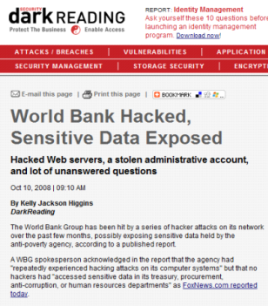
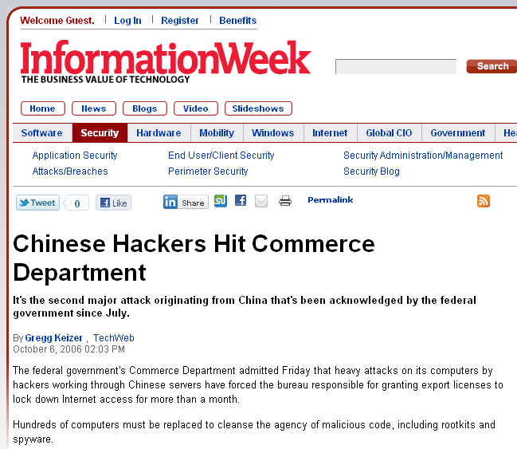
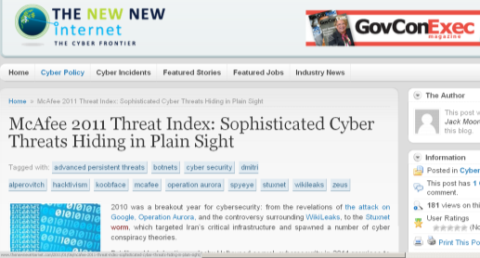
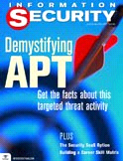
Threat/Risk Landscape
The Advanced Persistent Threat (APT) is a new level of threat sophistication that bypasses virtually all leading cybersecurity practices
The APT Challenge
Advanced
New paradigm: multiple vectors, custom-crafted
Undetectable and unpreventable by normal remediation techniques
Defies typical best practices
Persistent
APTs are highly targeted: attackers will not easily relent even if a counterstrike is launched
Attackers will find and breach any vulnerability, including social and organizational ones
Targeted
Victim organization is selected based on political, financial, and security interests
Individuals are targeted
Increasing Complexity
Complexity of attacks is high and constantly increasing
Even best-of-class security companies (e.g., Symantec) are currently vulnerable
“Companies of all sizes that have any involvement in national security or major global economic activities should expect to come under pervasive and continuous APT attacks...”
– McAfee 2011 Threats Predictions
Increasing Multitude
Number of attacks is increasing exponentially
The targets of attacks are increasing
Cost of Entry
Technology is getting cheaper and the cost for nation states or organized crime to fund these operations has gone down
Lower barriers to commit cyber crime with targets of attacks steadily increasing
Notes:
“WikiLeaks Has Bank of America Scrambling”
In December 2011, Bank of America was left scrambling after WikiLeaks threatened to expose an “ecosystem of corruption” by releasing tens of thousands of documents obtained from an executive’s hard drive.
“Email leak ousts HBGary Federal CEO”
HBGary Federal CEO, Aaron Barr, resigned after attackers “Anonymous” defaced the company’s Web site, hijacked Barr’s Twitter account, and released over 40,000 stolen emails revealing the firm was working on a plan to attack and discredit progressive critics of the US Chamber of Commerce, and had worked on ideas to take down WikiLeaks on behalf of Bank of America. Barr received threats of violence against individual members of his staff after the information was made public, and he had to go completely offline after the attackers tried to infiltrate his home router. Barr later told the Financial Times that he'd identified the "core leaders" of the group and had information that could lead to their arrest. He even claimed to have infiltrated "Anonymous" to demonstrate social media security risks.
“RSA: Security Experts Examine Lessons From WikiLeaks Scandal”
After WikiLeaks released over 100,000 government documents, security experts discussed the need to deter threats by WikiLeaks and others that attack on the notion that all information should be free.
“Massive Gmail Phishing Attack Hits Top U.S. Officials”
Hundreds of personal Gmail accounts, including some from senior U.S. government officials, were hacked as a result of a massive phishing scheme originating from China. The account hijackings were a result of stolen passwords, likely by malware installed on victims' computers or through victims' responses to e-mails from malicious hackers posing as trusted sources. That type of hack is known as phishing. According to Google, gmail's security systems themselves were not compromised.

Slide 12
Traditional Best Practices
Current Best Practices | APT Countermeasure
Anti-Virus | Compile malicious code immediately before use, protect with kernel driver, run code in Windows safe mode, pack with unknown packing utility
Vulnerability Assessments | Generally don’t rely on known system vulnerabilities, focus on mis-configured systems, non-vulnerability based targeted spear-phishing attacks, or application vulnerabilities (Adobe PDF Reader, MS Office)
Network Firewall | Target workstations, malicious code will beacon out, establishing a TCP session, attack over an open port (80, 53, 443, or email)
Host Firewall | Malicious code adds itself to the host firewall white list
Two-Factor Authentication (Common Access Cards) | Rootkit installed when user is logged in, then authenticate to the rootkit for future access, CAC not required for lateral movement
Email Filtering | Send link to malicious code vice the code itself, send from trusted email account, send from trusted network
Intrusion Detection Systems | Port 443, Open SSL, WinRAR, other encryption
Disabling HTML email | APTs don’t attempt to “hide” the link they are sending
Border Monitoring | Provided border protection from external attacks
Email Filtering | APTs don’t send attachments with .exe, .dll, .vbs, extensions – they send PDFs
Proxy Servers | HTTP header spoof - proxy server bypass
Microsoft Patching Program | Use of undocumented vulnerabilities, little or no focus on application patching
Notes:
12

Slide 13
Non-Traditional Risk Factors - Host
There are a number of traditional and non-traditional host-based risk factors that contribute substantially to your organization’s risk to Threat entrenchment
End users with local administrative access LAN Manager password hashes Shared local administrator passwords No proactive threat identification component Unmanaged and undermanaged systems Mobile users (especially with VPN) Adobe Acrobat patch level Web Browser patch level Non-sourced DA accounts MS Office version and service pack No HBSS, or HBSS with no Threat specific configuration

Slide 14
Non-Traditional Risk Factors - Network
There are a number of non-traditional network-based risk factors that contribute substantially to your organization’s risk to a sophisticated Threat
Flat network (Layer 3)
Flat authentication (Active Directory forests)
Excessive lateral movement allowed
Unproxied/unrestricted outbound access
Unmanaged systems on the network
Infrastructure servers with Internet access
Little or no internal network monitoring
Internally hosted public websites
Weak authentication VPN
Lack of proactive threat identification program
Poor Active Directory design and management

Slide 15
The preeminent organizational cyber challenges of 2012 consist of a blend of technical and organizational issues
Hypotheses on Top Cybersecurity Program Challenges
1
Abundance of sensors and data available; not enough analytics
Monitoring capabilities need to more inclusive of threat environment
Threat intelligence and analysis needs to be broader / more relevant
Threat Management
2
Control selection/implementation not risk-based in divisions/regions
Identified ‘cyber risks’ are narrowly focused on technology
Lack of interdependency analysis in risk management processes
Information Risk Management
3
Attackers / malicious code can move laterally throughout enterprise
Infrastructure security budget insufficient compared to growth
Expanding use of insecure mobile devices
Infrastructure Security
4
Massive global penetration of programmable logic controllers (PLCs) and other software-controlled products
Secure software/products soon to be competitive differentiator
Application Security
5
Large concentrations of sensitive data exist outside of well-protected environments
Sensitive information often flows across inadequately protected channels
Unsophisticated mechanisms are employed to assist and enforce end-user document labeling
Information Protection
6
A more dedicated and robust cybersecurity awareness, training, and education program needed
Internal users are not prepared for the modern threat environment
Third parties (e.g., contractors) require more engagement
Awareness, Training, & Education
7
Internal change management and security consulting entities are insufficient for engaging business units
Need for prioritization and phasing of interaction with stakeholders to address cybersecurity risks
Customers and third parties (e.g., vendors, contractors, partners) require more enhanced engagement
Communications & Engagement
8
Inconsistent monitoring and reporting of events or a lack of dedicated continuous monitoring capabilities
Reporting of real-time situational views are not tailored for stakeholders across the enterprise
Guidelines on internal and external escalation processes are not clear nor promulgated
Event Management
9
Governance is not addressed as a senior executive issue
Inconsistent and infrequent interaction with divisions to understand business risks and requirements
Organizational silos lead to ineffective processes / solutions
Governance

Slide 16
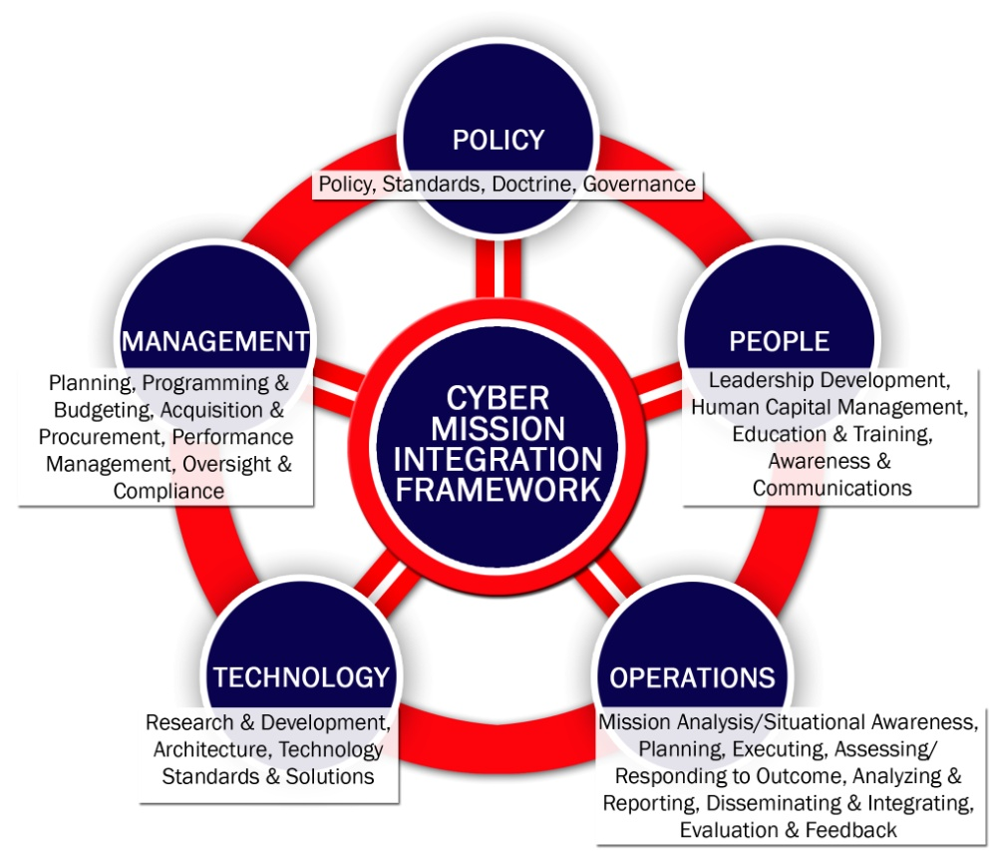
Resiliency must be integrated beyond purely technological areas, to include policies, human capital, management, and operations
Evolving Cybersecurity Capabilities
Using an Integrated Mindset
Highlights
Manage risk from a multidimensional perspective: Policy, People, Operations, and Management, in addition to Technology
Lower risk and become more cost efficient
Align cybersecurity needs to business mission
Craft effective solutions that are not stove-piped to a single area
Protect assets to enable business competitiveness and business reputation

Slide 17
Organizations need to develop all aspects of a cyber security workforce, including:
Strong Cybersecurity Workforce
Human Capital Management
To acquire, develop and retain cybersecurity talent
Leadership Development
To provide leaders with new cybersecurity competencies
Education and Training
To create a highly skilled cybersecurity workforce
Awareness and Communications
To create a cyber-aware, and cyber-active culture

Slide 18
There are defined 11 cyber roles that outline the skills and training requirements needed for a successful cyber workforce
Cyber Intel Analyst
Skills Needed/Training Requirements
Benefits
Cyber Business Professional
Cyber Policies, Plans, & Procedures
Cyber Program Design
Threat Assessment
Continuity of Operations
Incident Response
Certification & Accreditation
Vulnerability Assessment
Cyber Policy Analyst
Establishes a common lexicon and point of reference across all human capital management activities
Allows stakeholders to immediately identify roles, skill sets and training needs, consistently across functional areas
Allows existing staff to easily identify with each other to facilitate the formation of communities of interest and practice
Cybersecurity Analyst
Cyber Offense Analyst
Cyber Roles
Cyber Operations Planner
Cyber Compliance Analyst
Systems Requirements Analysis
Secure Network Design
Secure Application Design
Testing
Systems Implementation
Secure Configuration Management
Vulnerability Assessment
Secure Software Engineer
Cybersecurity Engineer
Cyber Strategist
Cyber Operations Professional

Slide 19
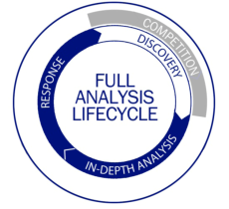
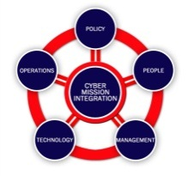
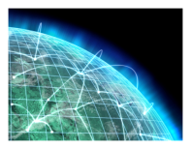

A “Dynamic Defense” approach will meet today’s need for resiliency by establishing a network of integrated processes, technologies, and people
2
Rapid Response
Find and react to adversarial threats
Recognize attack
Conduct triage
Perform forensics
Respond to attack
Recover/reconstitute
Situational
Awareness
Lessons
Learned
1
Threat Vector Intelligence
4
Mitigation
Integrated Remediation
Gather insights on adversary threats, intentions, and capabilities
Build/implement better systems and constructs to keep adversaries out
All-source analysis
Indications of “early warning”
Threat education
Support to operations,
planning and institutional
cybersecurity programs
Risk
Informed Decisions
Response
Policy
Operations
Technology
Management
People
Mitigation
3
Actionable
Insights
Evolutionary Response
Design capabilities to counter adversarial threats
Best
Practices
Capability maturity evolution
Vulnerability assessment
Trade-off analysis
Operational planning
Exercises/M&S
Strategic road-mapping

Slide 20
Contact Information
Roger Cressey
Senior Vice President
Booz Allen Hamilton
Mclean, Virginia
USA
+1 703 9841421
Cressey_roger@bah.com

